Slide 1
Announcements
Complete first draft of papers due this Saturday (Mar 1)
no bullet points, all sections completed
Peer Feedback coming today
Poster comments/grades coming Thursday
Final paper, oral presentations start Mar 13, continue into finals week

Slide 2
Paper assignments
You MUST follow the template on Canvas for your paper!
These sections make a complete paper:
Title
Abstract
Introduction
Methods
Results
Discussion
Acknowledgements
References
Any tables and figures with captions

Slide 3
What questions do you have about your research paper?

Slide 4
The point of a first draft is not to get it right, but to get it written.
It is way easier to edit existing writing than to write from scratch.
Try to write something (anything) rather than leave things blank or bulleted.
No, I will not judge you if your draft is not perfect. My first drafts are never perfect either.
We will have time to edit drafts

Slide 5
The Abstract
Fish 290
Tuesday Feb 25

Slide 6
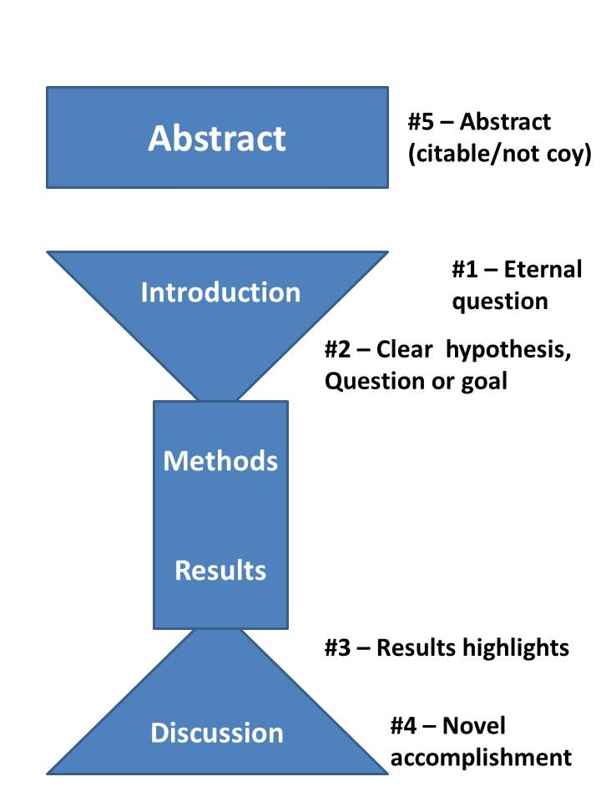
Recall paper structure and the 5 pivotal paragraphs
Now we are here
Good advice found here:
https://dynamicecology.wordpress.com/2016/02/24/the-5-pivotal-paragraphs-in-a-paper/

Slide 7
Most readers will only read three things:
Title
Abstract
Figures
Think: if the reader only sees these 3 sections, what do I want them to take away?

Slide 8
What is an abstract?
An abstract is a brief summary of a study, with the purpose of helping the reader quickly ascertain the study’s role
From 150–300 words

Slide 9
What goes into an abstract?
An abstract should mimic the structure of the paper:
2-4 sentences giving background context
Statement of objectives
1-2 sentences on overall approach to answering question, including key details like study site
2-3 sentences giving key results, in plain language
2-3 sentences giving interpretation and broader implications of key results

Slide 10
What goes into an abstract?
What does not go into an abstract:
In-text citations
Statistical details like a p-value (however, sample sizes are easy enough to digest)

Slide 11
What makes an abstract successful?
The biggest mistake when writing the abstract is being vague or hiding the key results.
Unlike a movie, there is no reason to avoid spoilers
Each sentence in the Abstract is valuable and should have a purpose.
Do not be vague (“Various results are shown.”)
Do not simply start writing and stop when you hit 300 words.

Slide 12
Now on canvas
Using the template I just provided, let’s break down published abstracts on Canvas.
Download ‘abstracts to highlight.doc’

Slide 13
What goes into an abstract?
An abstract should mimic the structure of the paper:
2-4 sentences giving background context
Statement of objectives
1-2 sentences on overall approach to answering question, including key details like study site
2-3 sentences giving key results, in plain language
2-3 sentences giving interpretation and broader implications of key results

